Slide 1

Linux

Slide 2

What is it?
Linux Kernel
Linux OS Distributions

Slide 3
Why Linux
Free and Open Source (FOSS)
Scalable
Secure
Fast

Slide 4
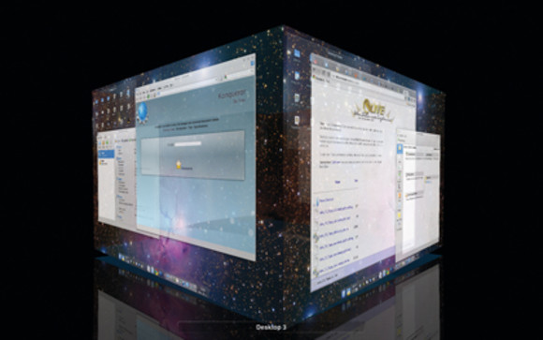
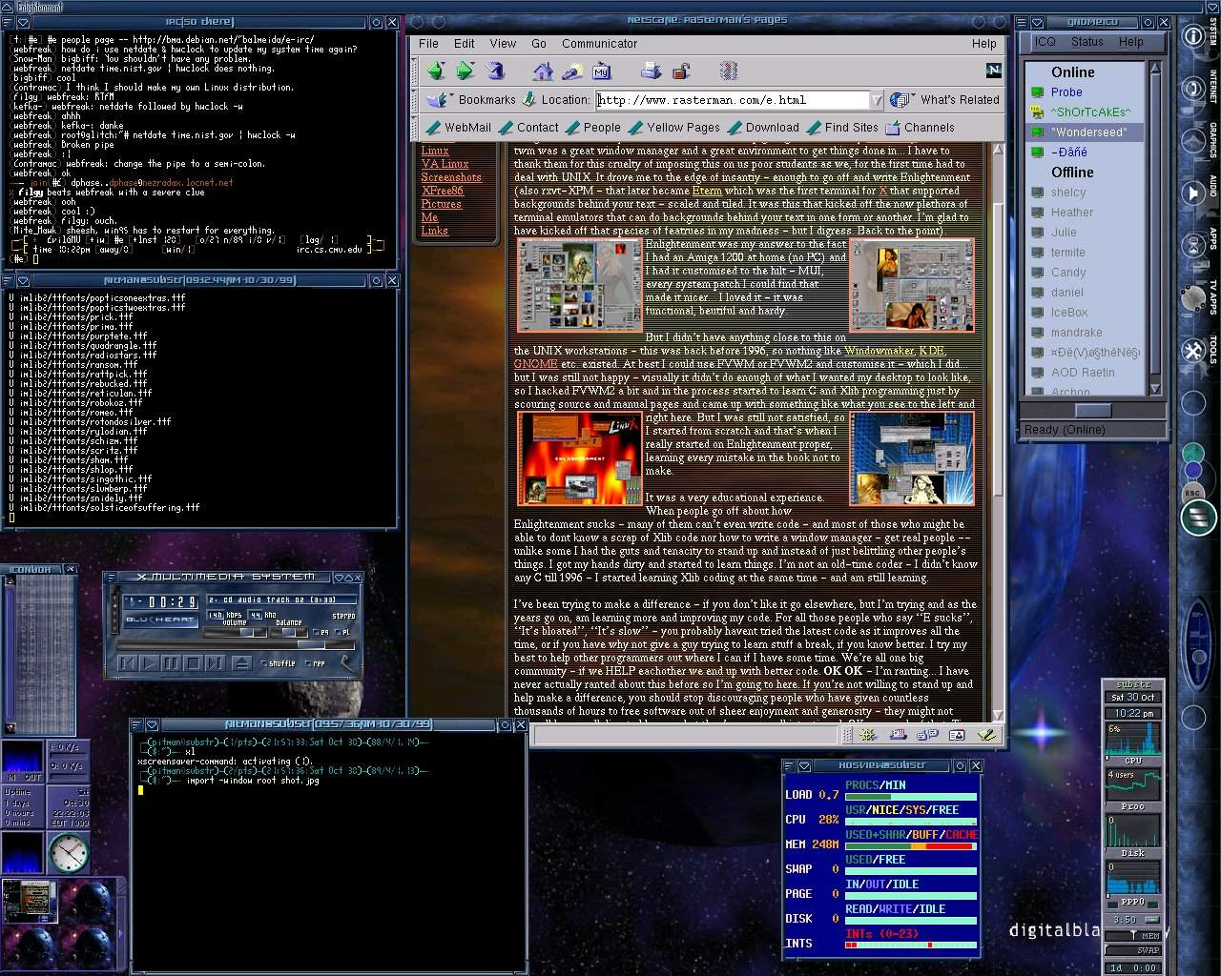
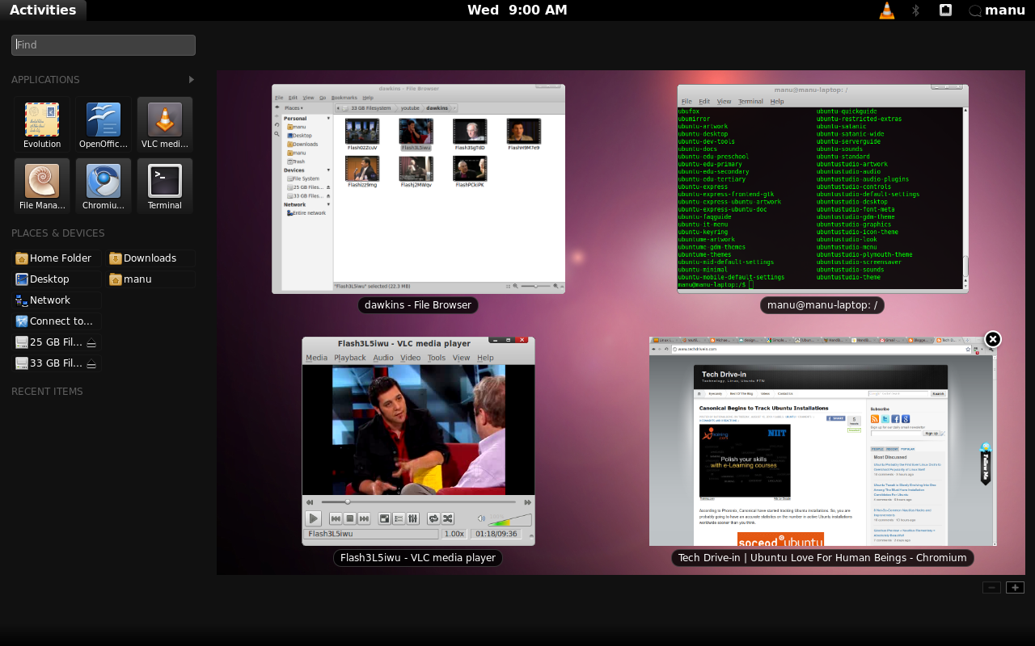
Linux Features
Customization
Package Management
Fully functional terminal
Quick Release Cycle
Easy to run as a server

Slide 5
Intro To Learning Linux
VIM Adventures: http://vim-adventures.com/
Linux in your browser: http://bellard.org/jslinux/
  “ls” or “ls -l” to show files in the directory
  “cd” to change directory
  “top” is like task manager
  “vi” to open text editor
    -”i” to start writing
    -”:wq” to save and quit
  “cat $filename” (where $filename is the file) to print file
  “echo hello” to print the text “hello”
  Google more “common linux commands”

